Slide 1
Raspberry pi based Surveillance Robot for Real Time Intrusion Detection and Tracking
Aniruddh Bhagwat 405B005
Manav Chouhan 405B018
Rohit Kshirsagar 405B036
Prashant Kumar 405B049

Slide 2
Problem Statement
Make a surveillance robot to ensure safety of the house, identify the intruder, track him and alert the owner.

Slide 3
Motivation
With increase in workforce of the country, the houses remain vacant when it’s members are out there in offices. Hence there is :
Need to ensure security of house.
Need of an assistant in house.
Need to alert owner if someone unwanted comes in.
We aim to build a surveillance robot that solves the above needs.

Slide 4
Objective
Once completed the robot will solve the following requirements:
Identify the person as known or unknown, when the person enters.
Alert the owner if the person is unknown, send an image of intruder to the owner.
Follow the intruder and send his actions to owner.
Take next set of instruction from owner and work accordingly.
Return to its original position.

Slide 5
Idea Matrix
Scoring 1 = Low 2 = Moderate 3 = High | Different or Better | Delivers Value | Doable, Practical | Potential for early adopters | Score
Person Identification, Communication & Tracking Robot | H | M | H | H | 11
Domestic Help Robot | M | H | L | M | 8
Home Automation Robot | L | H | M | H | 9

Slide 6
Hardware Requirements
Raspberry Pi 3B
Ultrasonic Sensor Module HC-SR04
ROBOT Chassis
Wheels, DC Motors
Raspberry pi 5MP camera
Bread Board
Resistor (1k)
Motor Driver L298 2A
Connecting wires
Power supply or Power bank

Slide 7
Software Requirements
Python3 and necessary libraries.
Text Editor
Raspberry pi OS
VnC Server
Telegram app

Slide 8
Literature Survey
Title | Published Year | Basic Idea
Human Detection and Tracking for Video Surveillance: A Cognitive Science Approach | 2017 | Detect human beings in any frame. Find the movement patterns of the humans in the frame.
Obstacle Detection and Avoidance Robot | 2018 | Detect and avoid any obstacles in the path. Focuses on the edge detection for higher accuracy.
Design and Implementation of an Autonomous Indoor Surveillance Robot based on Raspberry Pi | 2019 | Identify the person and alert the owner. Take necessary actions through the commands given by the owner.

Slide 9
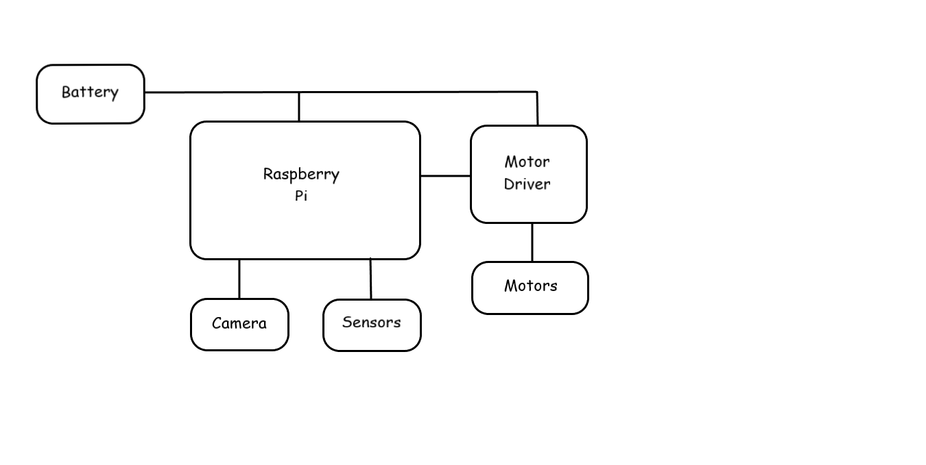
System Architecture

Slide 10
Single Shot Detection Algorithm
Single Shot detector takes only one shot to detect multiple objects present in an image using multibox. It is significantly faster in speed and high-accuracy object detection algorithm.
SSD divides the image using a grid and have each grid cell be responsible for detecting objects in that region of the image. Detection objects simply means predicting the class and location of an object within that region.

Slide 11
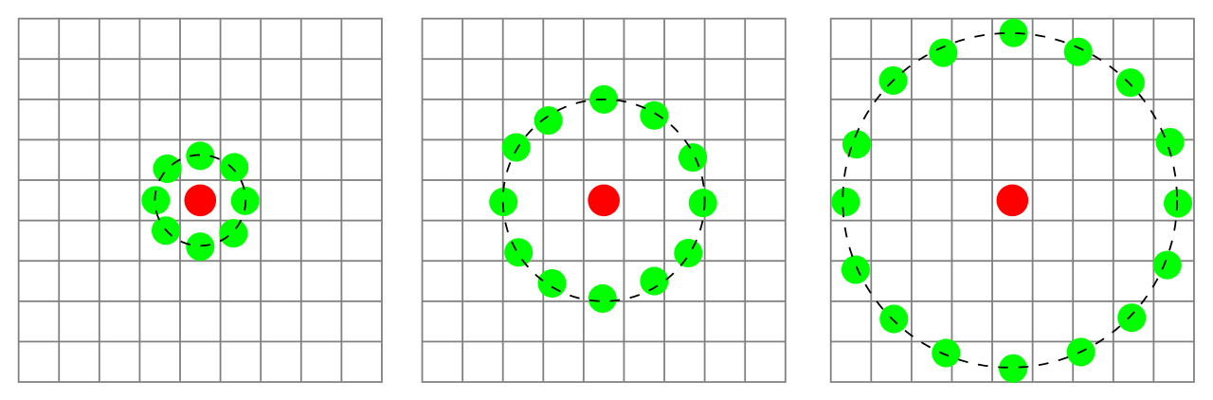
Local Binary Pattern
Local Binary Pattern (LBP) is a simple yet very efficient texture operator which labels the pixels of an image by thresholding the neighborhood of each pixel and considers the result as a binary number.
The algorithm uses a concept of a sliding window, based on the parameters radius and neighbors.
Figure: Three neighborhood examples used to define a texture and calculate a local binary pattern (LBP).

Slide 12
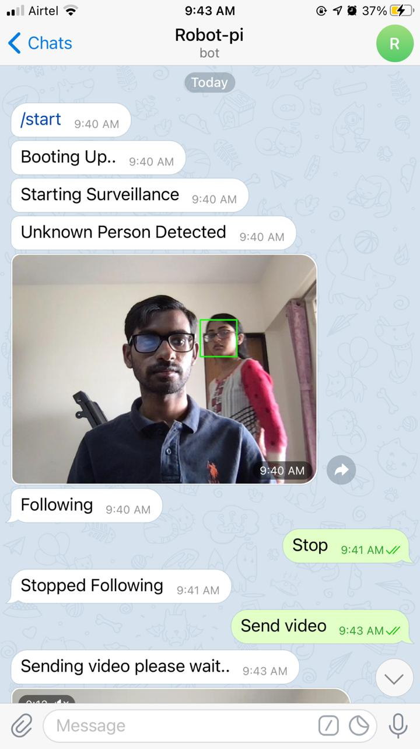
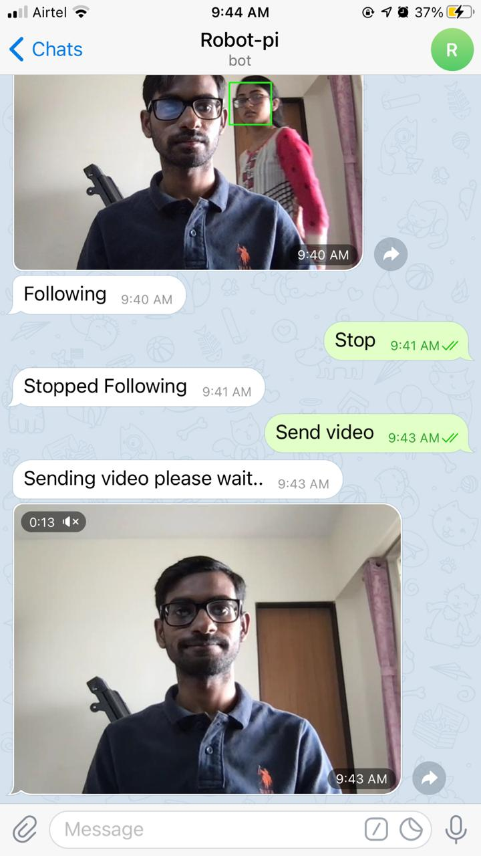
Frontend Images

Slide 13
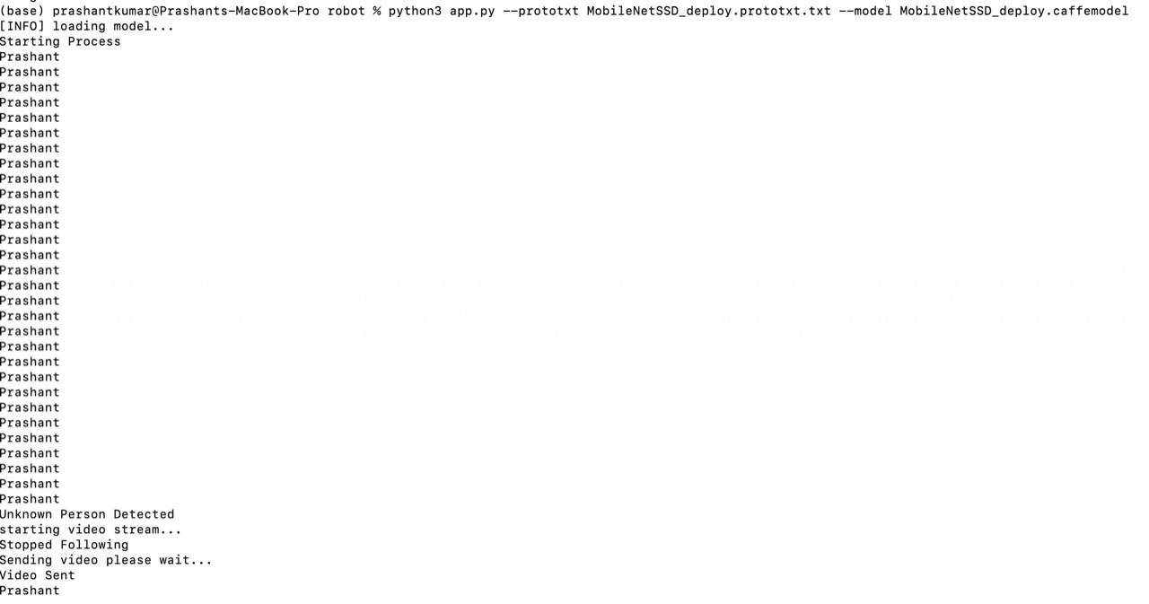
Backend Image

Slide 14
Conclusion
Even though the development cost is kept as low as possible, the system is capable of navigating autonomously while engaged in surveillance, recognizing intruders via facial recognition.

